Slide 1
BLOOD BANK MANNAGEMNT SYSTEM

Slide 2
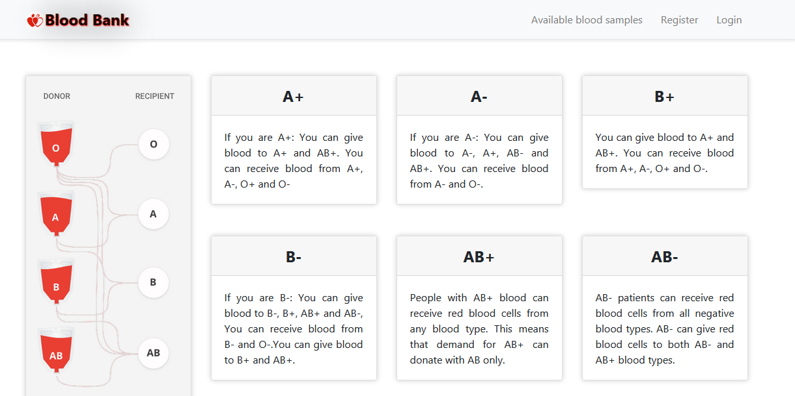
Home page

Slide 3
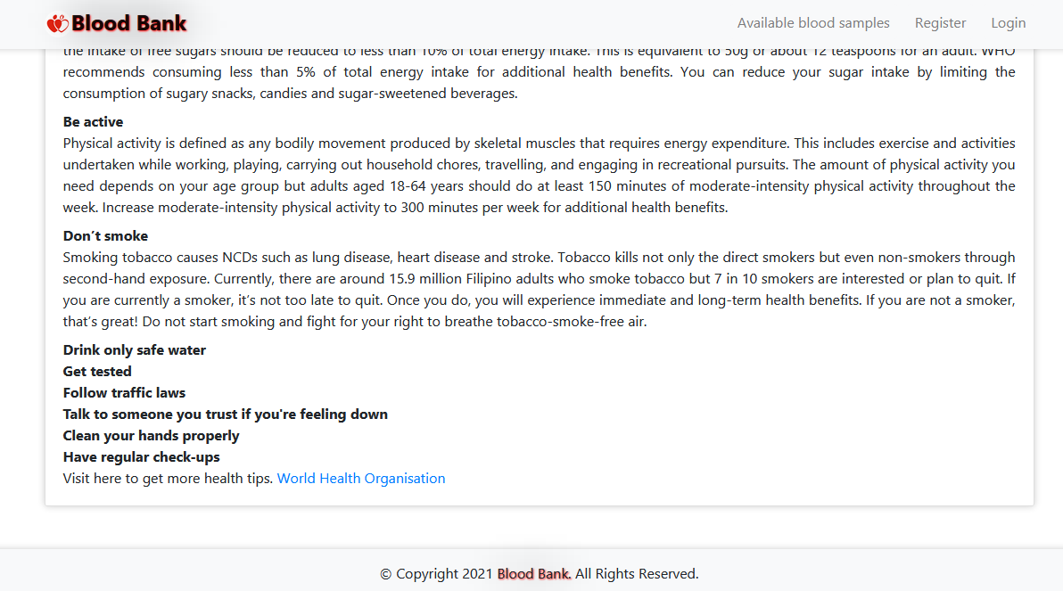

Slide 4
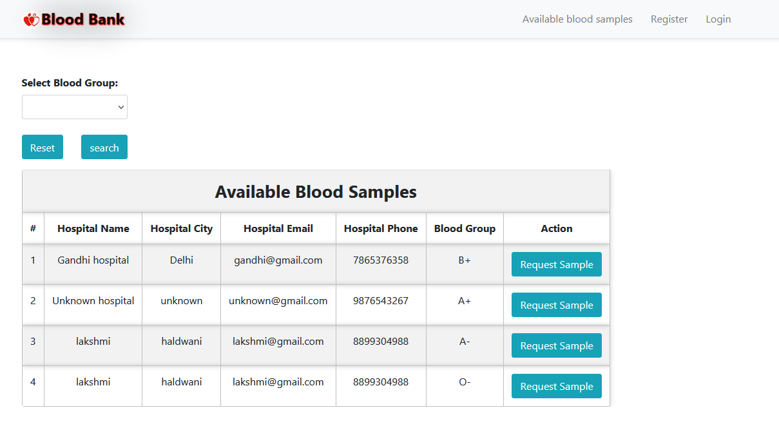
Available Blood Group Page

Slide 5
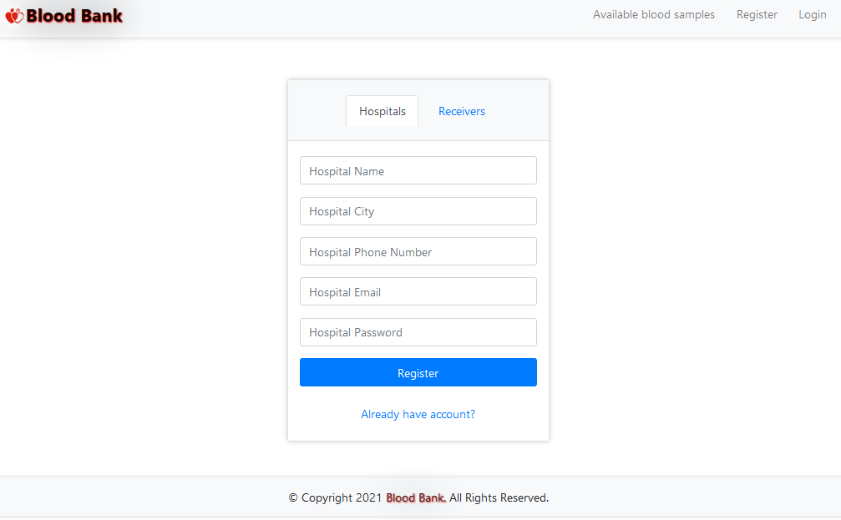
Hospital Register page

Slide 6
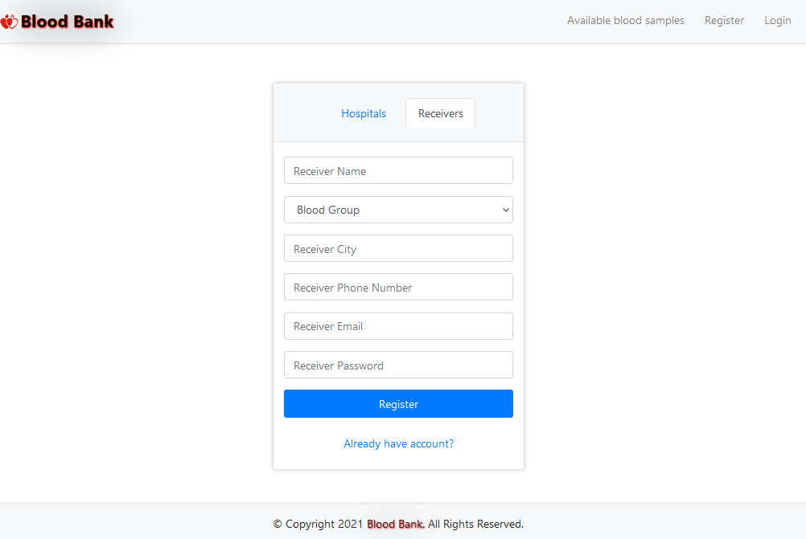
Receiver Registration page

Slide 7
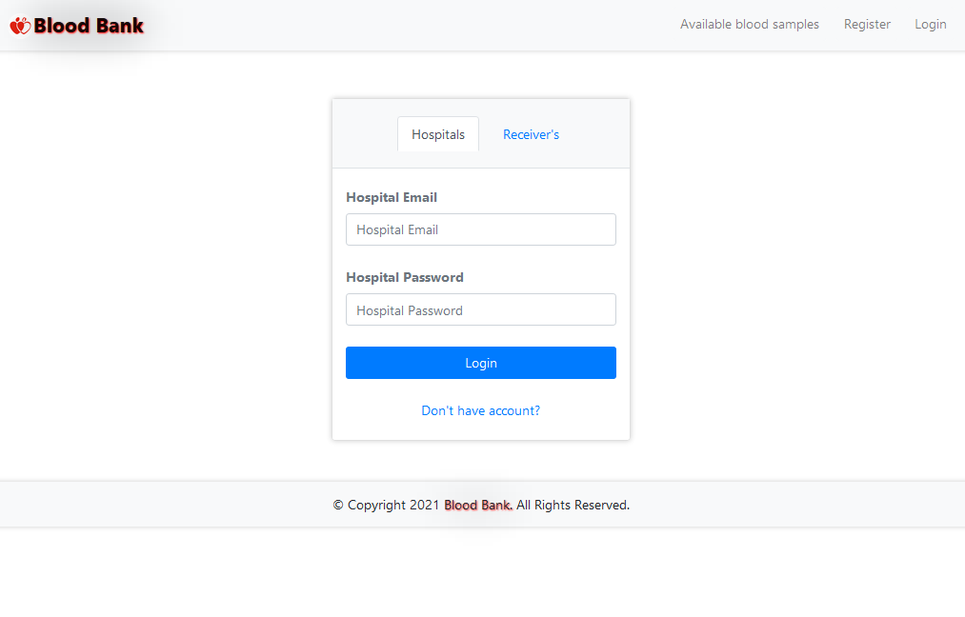
Hospital And Receiver Login Page

Slide 8
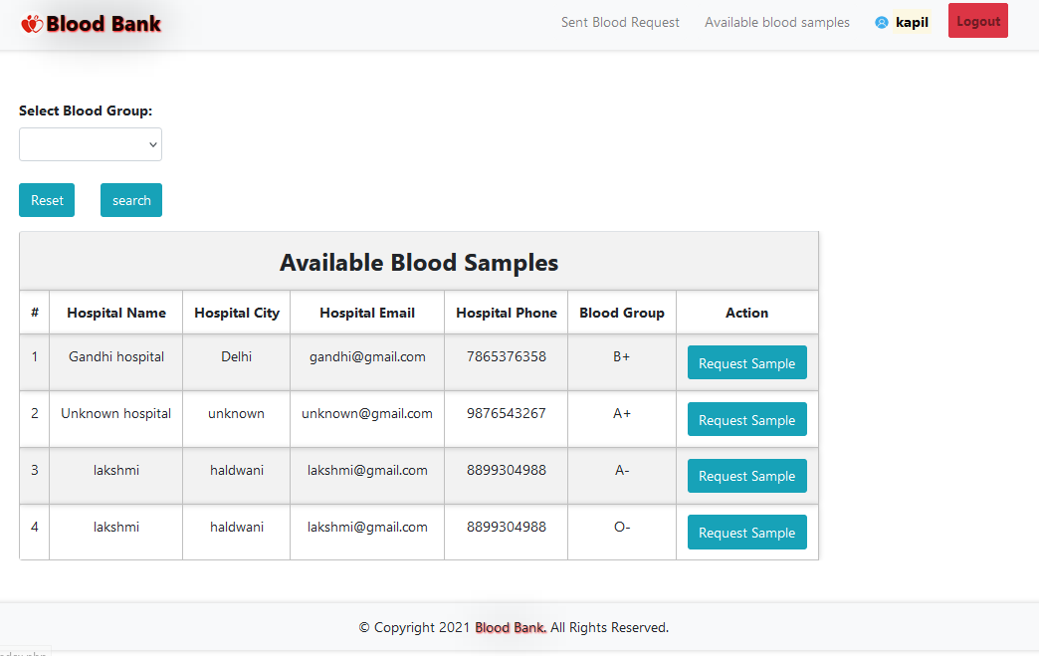
Available Blood And Request

Slide 9
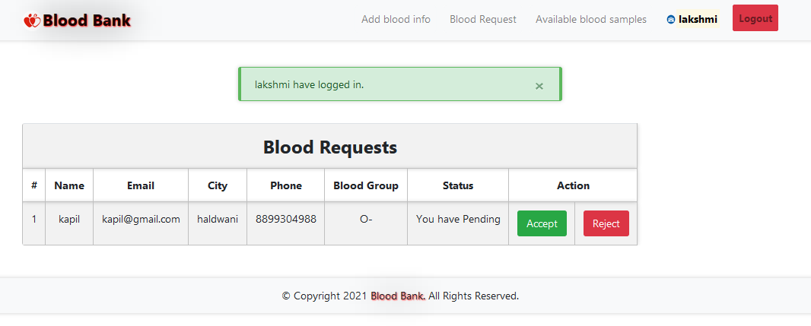
Blood Request Accept And Reject By Hospital

Slide 10
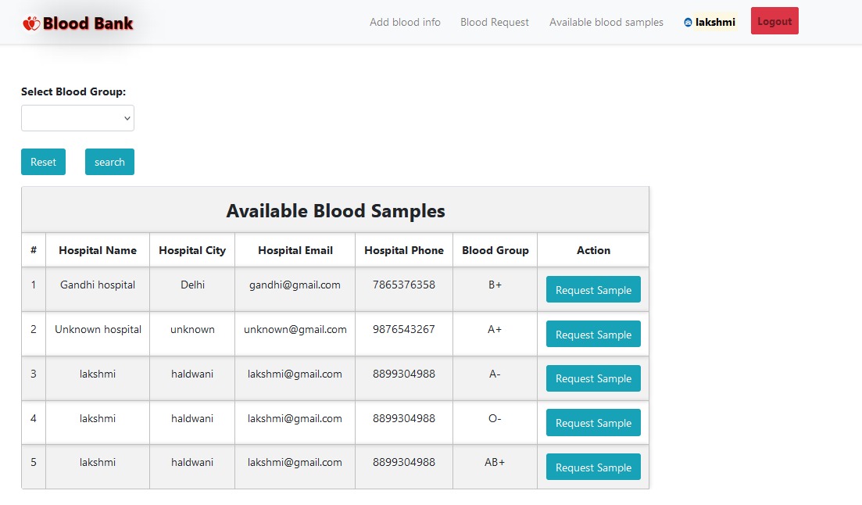
Hospital Request Blood From Other Hospitals

Slide 11
Thank you

